Slide 1
Decision Trees
Geoff Hulten

Slide 2
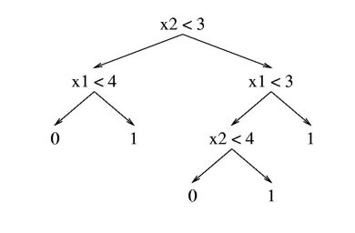
Overview of Decision Trees
A tree structured model for classification, regression and probability estimation.
CART (Classification and Regression Trees)
Can be effective when:
The problem has interactions between variables
There aren’t too many relevant features (less than thousands)
You want to interpret the model to learn about your problem
Despite this, simple decision trees are seldom used in practice.
Most real applications use ensembles of trees (which we will talk about next week).

Slide 3
Reminder: Components of Learning Algorithm
Model Structure
Loss Function
Optimization Method

Slide 4
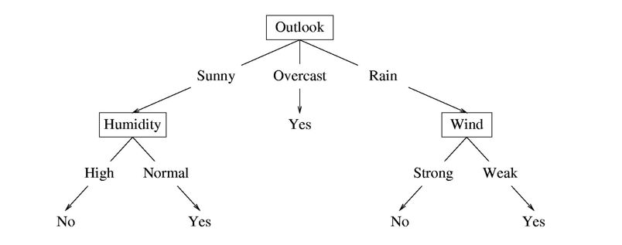
Structure of a Decision Tree
Internal nodes test feature values
One child per possible outcome
Leaves contain predictions
Humidity | Outlook | Wind | Prediction
Normal | Rain | Strong
High | Sunny | Normal

Slide 5





Decision Trees: Basic Tests
$$x_{i}=0?$$
Binary Feature
Categorical Feature
Numeric Feature
False
True
$$x_{i}?$$
$${Value}_{1}$$
$${Value}_{n}$$
…
$$x_{i}<101.2?$$
False
True

Slide 6



Decision Trees: Leaf Types
Classification
Regression
Probability Estimate
$$y=1$$
$$y=101.2$$
$$p\left(y=0\right)= .3$$
$$p\left(y=1\right)= .3$$
$$p\left(y=2\right)= .4$$

Slide 7
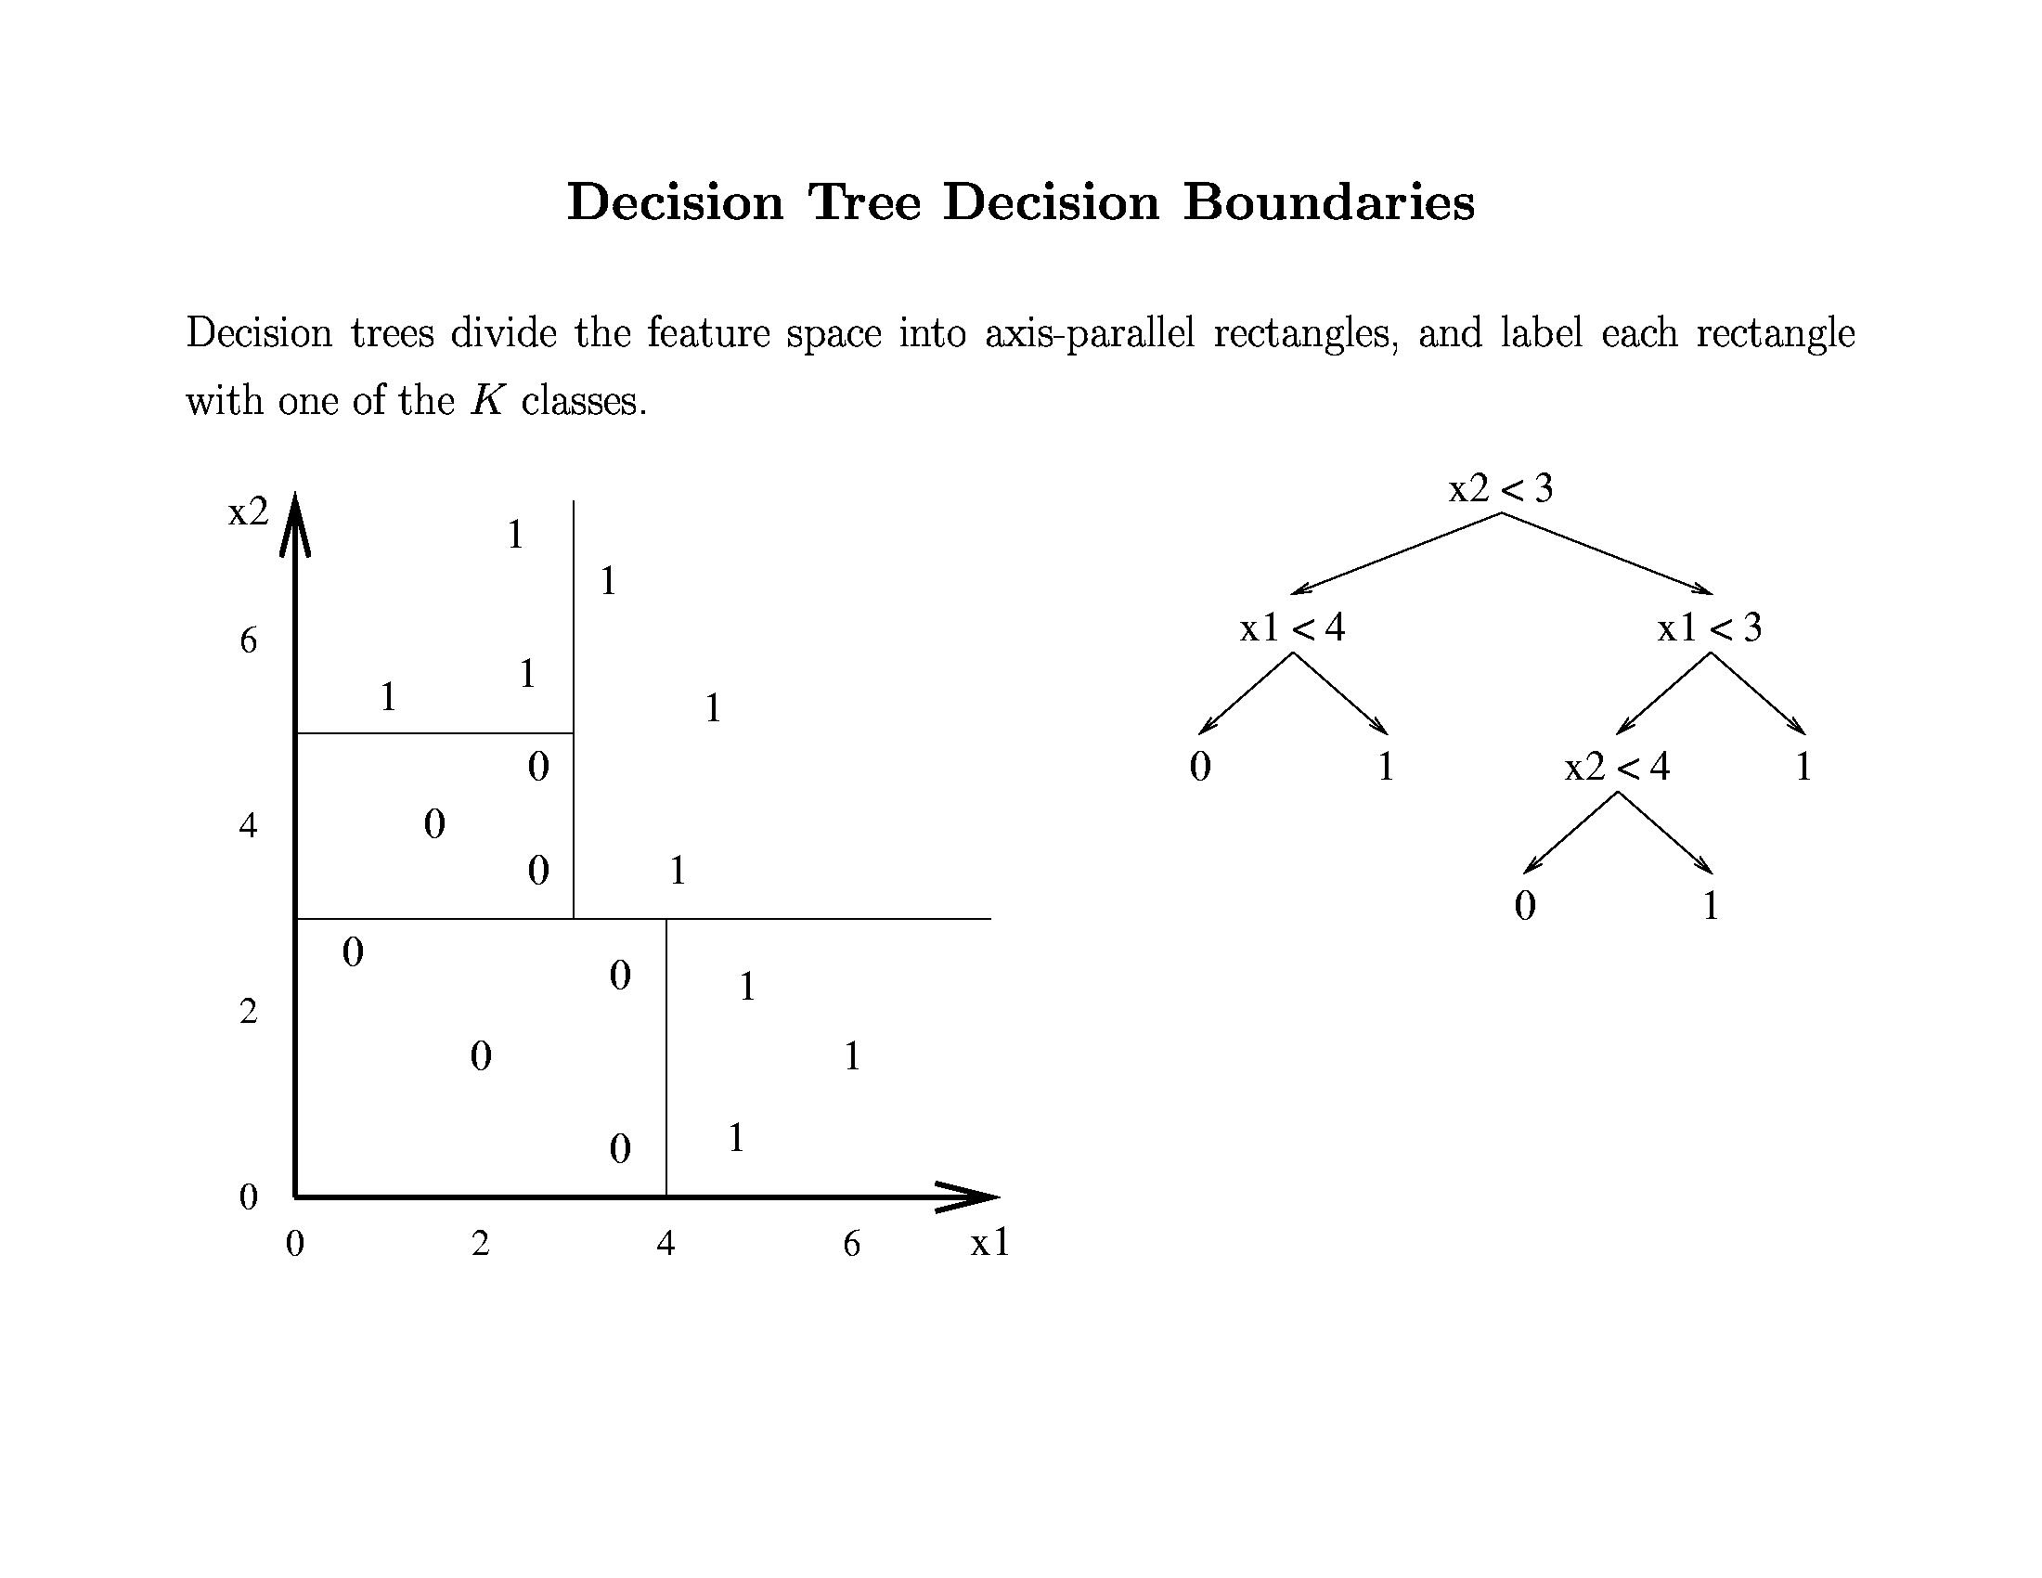

Slide 8
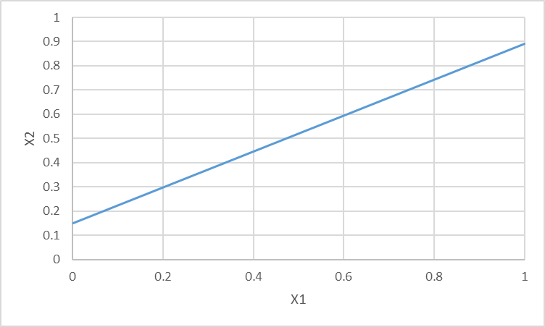
Decision Trees vs Linear Models

Slide 9
Summary of Decision Tree Structure
Supports many types of features and predictions
Can represent many functions (may require a lot of nodes)
Complexity of model can scale with data/concept

Slide 10
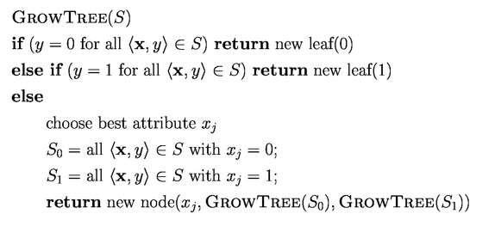
Decision Tree Optimization (preview)

Slide 11

Not the Loss Function for Decision Trees
$$Loss\left(y^{^},y\right)= \frac{1}{n}\sum_{i=1}^{n}{0 if\left(y^{^}=y\right)else 1}$$
Training set error rate
Using this to:
Give a simple example of optimizing
Give an example of why this fancy log(blah, blah) stuff matters

Slide 12
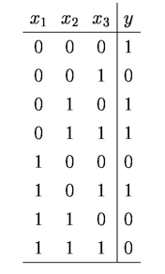
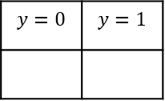

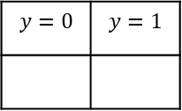

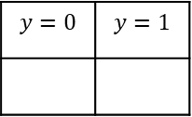
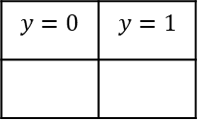
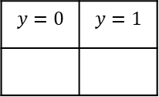
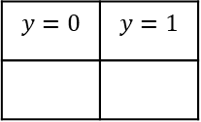

An Example of Growing Decision Trees
$$x_{1}=1?$$
$$x_{2}=1?$$
False
True
False
True
$$y=0$$ | $$y=1$$
$$y=0$$ | $$y=1$$
$$y=0$$ | $$y=1$$
$$y=0$$ | $$y=1$$
$$x_{3}=1?$$
False
True
$$y=0$$ | $$y=1$$
$$y=0$$ | $$y=1$$

Slide 13
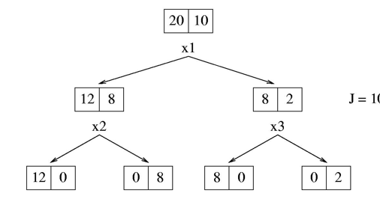



Trouble with Training Set Error…
Error $≈$ 33%
Error $≈$ 33%
Error $=$ 0%

Slide 14
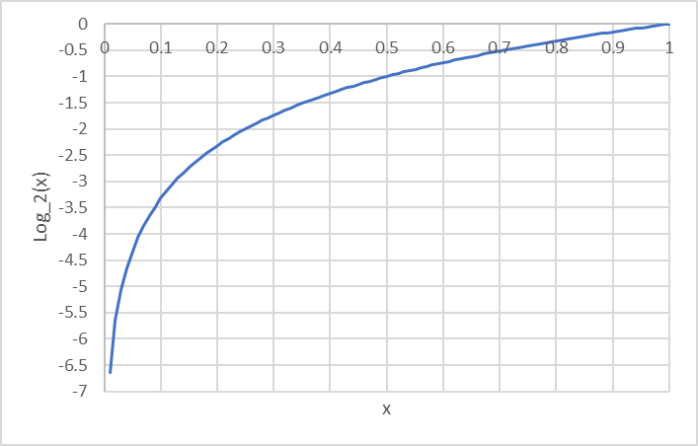
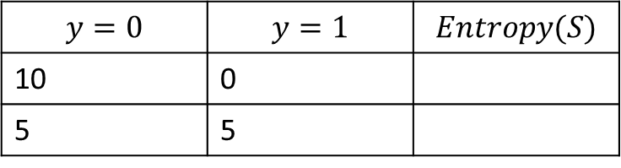

Entropy of a distribution
$$Entropy\left(S\right)=−\sum_{i∈\{y\}}{p\left(y=i\right)∗\log_{2}(p\left(y=i\right))}$$
$$y=0$$ | $$y=1$$ | $$Entropy(S)$$
10 | 0
5 | 5

Slide 15


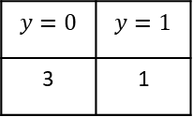
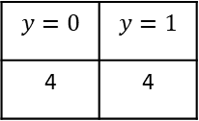
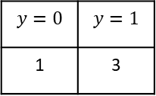
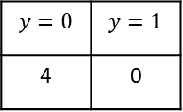

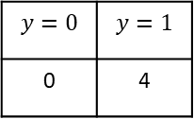
Loss for Decision Trees
$$Loss\left(x\right)= \frac{1}{n}\sum_{i=1}^{n}{Entropy(Leaf\left(x_{i}\right))}$$
$$y=0$$ | $$y=1$$
4 | 4
$$x_{1}=1?$$
False
True
$$y=0$$ | $$y=1$$
1 | 3
$$y=0$$ | $$y=1$$
3 | 1
$$x_{?}=1?$$
False
True
$$y=0$$ | $$y=1$$
0 | 4
$$y=0$$ | $$y=1$$
4 | 0

Slide 16
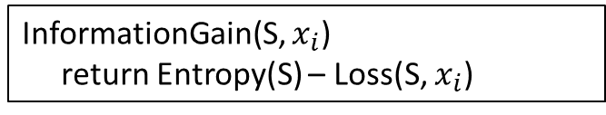
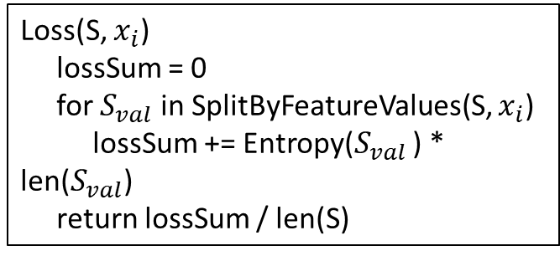
Decision Tree Optimization
Loss(S, $x_{i}$)
lossSum = 0
for $S_{val}$ in SplitByFeatureValues(S, $x_{i}$)
lossSum += Entropy($S_{val}$ ) * len($S_{val}$)
return lossSum / len(S)
InformationGain(S, $x_{i}$)
return Entropy(S) – Loss(S, $x_{i}$)
BestSplitAtribute(S)
informationGains = {}
for i in range(# features):
informationGains[i] = InformationGain(S, i)
if AllEqualZero(informationGains):
return <NONE>
return FindIndexWithHighestValue(informationGains)

Slide 17
Splitting Non-binary Features
Categorical Features
One child per possible value
One vs the rest
Set vs the rest
Numerical Features
Split at each observed value
Split observed range evenly
Split samples evenly

Slide 18
Stopping Criteria?
When no further split improves Loss
Run out of features
Min loss reduction to split
Leaf is pure
When there isn’t enough data to make good decisions
Min number of samples to grow
When the model is complex enough
Number of nodes in the tree
Maximum depth of the tree
Loss penalty for complexity
Hybrid
Very common…
Decision trees tend to overfit
Pruning?

Slide 19
Predicting with Decision Trees
Take the new sample, pass it through the tree until it reaches a leaf:
Binary classification
Return most common label among training samples at the leaf
Categorical classification
Return most common label among training samples at the leaf
Probability estimate
Return (smoothed) probability distribution defined by samples at leaf
Regression
Return the most common value at leaf
Linear regression among samples at leaf

Slide 20
Interpreting Decision Trees
Understanding Features
Near the root
Used many times
Big loss improvements in aggregate
Prominent paths
Taken by many samples
Highly accurate
Taken by important (expensive) samples

Slide 21
Decision Tree Algorithm
Recursively grow a tree
Partition data by best feature
Reduce entropy
Flexible and simple
Feature types
Prediction types
Parameters
How to partition by features (numeric)
How to control complexity
Base to important algorithms
AdaBoost (stumps)
Random forests
Gradient boosting machines

